Slide 1
Spring Boot Thymeleaf CRUD example
What you learn from this Tutorial till the end
How to configure Spring Data, JPA, Hibernate to work with Database
How to define Data Entity and Repository interfaces
Way to create Spring Controller to process HTTP requests
Way to use Spring Data JPA to interact with H2/MySQL/PostgreSQL Database
How to use Thymeleaf template engine for View layer

Slide 2
Technology Used
Java 8 or Higher Version
Spring Boot (with Spring Web MVC, Spring Data JPA, Thymeleaf)
H2/MySQL/PostgreSQL Database
Maven
Bootstrap 4
jQuery
Font Awesome

Slide 3
Operation performed on Student API
 | url or API Path | What Action will it do?
Student API Path and there action | /students/all | create new Student
 | /students/keyword | retrieve all Students by keyword
 | /students/new | Go To Student Form
 | /students/save | Save Student Form Details in DB
 | /students/{id} | Edit Student with id
 | /students/delete/{id} | Delete Student with id
 | /students/{id}/result/{status} | Update Result Status Result=1(Pass) and Result=0(Fail)

Slide 4
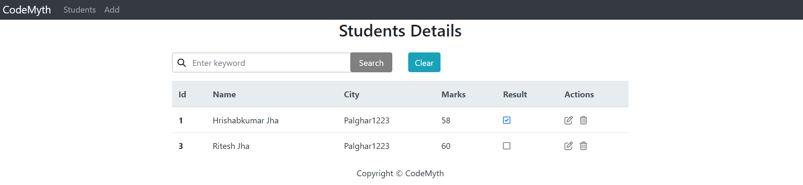
Student API Thymleaf will look like –path : /students/all

Slide 5
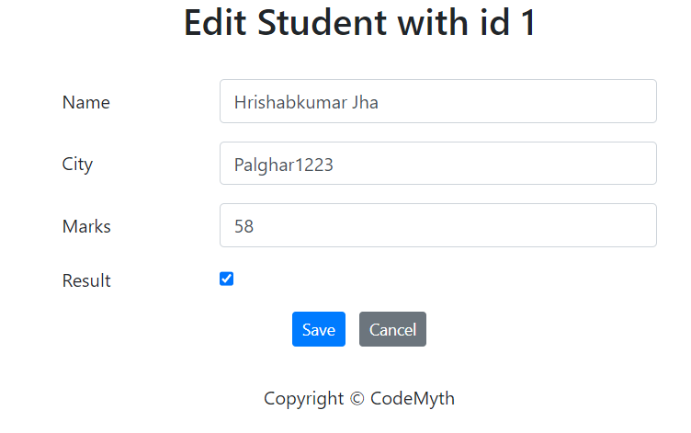
Student API Thymleaf will look like –path : /students/{id}

Slide 6
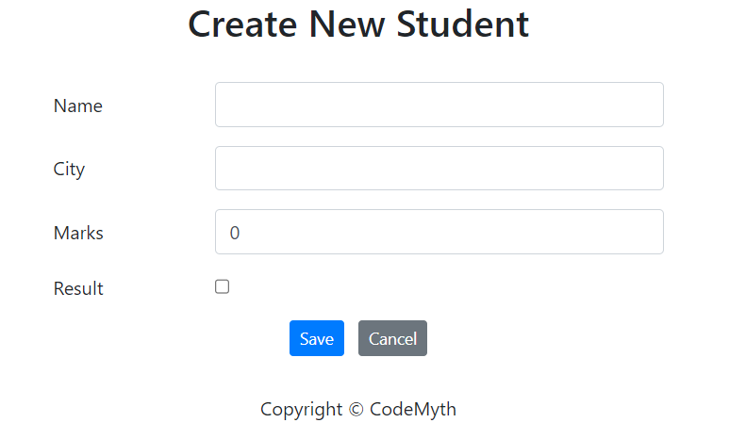
Student API Thymleaf will look like –path : /students/new

Slide 7
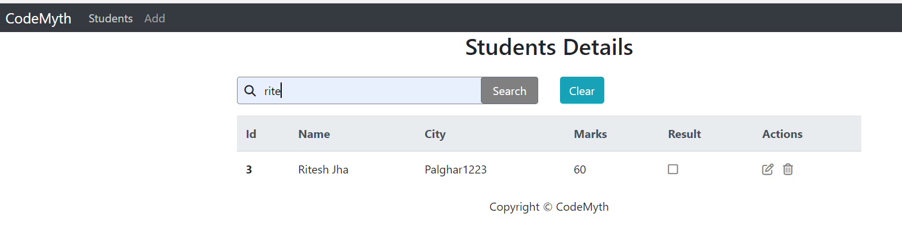
Student API Thymleaf will look like –path : /students/keyword

Slide 8
Lets Start Coding Now ☺

